Slide 1
Project Presentation of CO-OP Project at Industry (Module-2) (22CS421)
On
Illusions of Performance: Train–Test Leakage in Similarity Search Benchmarks
Diya Gupta - 2210990303
Aakanksha Sharma - 2210990006
Siya Bansal - 2210992386
Supervised By
Mrs. Swati Goel
Department of Computer Science and Engineering,
Chitkara University, Punjab

Slide 2
Introduction
Dense vector retrieval is widely used in modern AI systems.
Applications include:
1. Semantic Search
2.Recommendation Systems
3.Question Answering
4.Information Retrieval
Approximate Nearest Neighbor (ANN) systems like FAISS are commonly used for efficient similarity search.
Retrieval performance is evaluated using metrics such as Recall@K and Mean Reciprocal Rank (MRR).
A major issue in benchmark evaluation is train–test leakage.
Leakage occurs when test queries or semantically similar vectors already exist inside the retrieval corpus.
This contamination can distort benchmark results and reduce evaluation reliability.
Our work focuses on understanding how train–test leakage affects similarity search benchmark performance.
2

Slide 3
Problem Statement
Similarity search benchmarks assume that test queries and corpus data are completely separate.
In real-world datasets, semantically similar or near-duplicate vectors may already exist inside the retrieval corpus, which creates train–test leakage in similarity search systems.
ANN systems retrieve vectors based on similarity, so leaked vectors can interfere with correct retrieval.
Near-duplicate vectors may occupy top-ranked positions and replace actual ground-truth neighbors, causing distorted rankings and misleading benchmark evaluation results.
Leakage becomes difficult to detect because even highly similar embeddings can affect retrieval performance without being exact duplicates.
Existing benchmark studies mainly focus on speed and efficiency, but not on leakage validation.
Therefore, reliable methods are needed to detect and analyze train–test leakage in similarity search systems.
3

Slide 4

Objectives
Study train–test leakage in similarity search benchmarks.
Define leakage using cosine similarity thresholds.
Develop a leakage detection protocol.
Inject controlled contamination into retrieval corpus.
Analyze the effect of leakage on retrieval performance.
Evaluate metrics such as Recall@1, Recall@5, Recall@10, and MRR.
Compare semantic leakage with random injection.
Study contamination effects on different embedding datasets.
Improve reliability of ANN benchmark evaluation systems.
4

Slide 5
Related Work
• Johnson et al. developed FAISS for efficient ANN similarity search and focused mainly on retrieval efficiency and scalability.
• ANN-Benchmarks evaluated ANN systems using Recall@K and query speed but assumed clean benchmark datasets.
• Kaufman et al. studied data leakage in supervised learning, while Brown et al. discussed benchmark contamination in GPT-3.
• Existing near-duplicate detection methods use cosine similarity and embedding-based comparison for dataset cleaning.
• Most previous studies focused on:
Retrieval efficiency
Indexing performance
Scalability
• However, limited research focused on:
Train–test leakage in ANN systems
Semantic contamination in retrieval benchmarks
Impact on Recall@K and MRR
• Our work analyzes train–test leakage and its effect on similarity search benchmark performance.
5

Slide 6
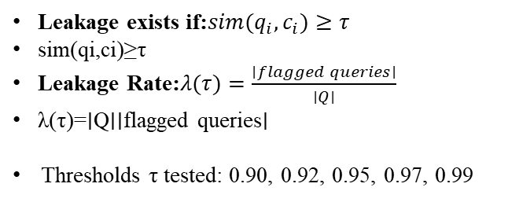
System Architecture & Methodology
1.
Dataset
Preparation
Synthetic-128D
& NLP-768D
2.
BUILD Ground Truth (q)
Exhaustive NN
Top-10
3.
Leakage
Detection
FAISS Flat
Cosine ≥ τ
4.
Leakage
Injection
Gaussian noise
0–30%
5.
Evaluate
Metrics
Recall@K
& MRR
Formal Definition of Leakage
FAISS Index Configuration
Leakage exists if:$sim(q_{i},c_{i})≥τ$
sim(qi​,ci​)≥τ
Leakage Rate:$λ(τ)=\frac{∣flagged queries∣}{∣Q∣}$
λ(τ)=∣Q∣∣flagged queries∣​
Thresholds τ tested: 0.90, 0.92, 0.95, 0.97, 0.99
Index Type: IVF-Flat (nlist = 256, nprobe = 32)
Similarity Metric: Inner Product (Cosine after L2 normalization)
Contamination Levels: 0%, 5%, 10%, 20%, 30%
5 experimental runs with fixed random seeds
Methodology Goal
To analyze how train–test leakage affects retrieval performance under controlled contamination levels.
6

Slide 7
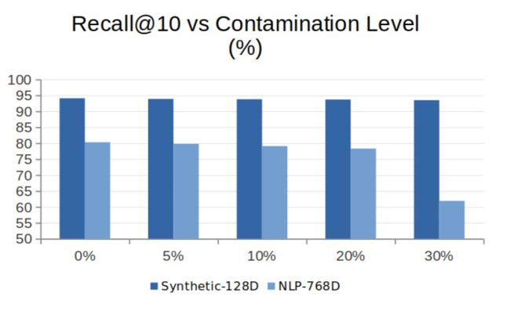
Results & Discussion
Key Findings:
Recall@1 drops by 29 pp at 30% contamination (NLP-768D).
Recall@1 is the most sensitive diagnostic metric.
Synthetic-128D is far more robust than NLP embeddings.
MRR declines proportionally across both datasets.
Semantic proximity — not corpus size — causes degradation.
Detection protocol: 0 false positives on clean benchmarks.
29pp
Max Recall@1
Drop
18.4pp
Max Recall@10 Drop
0.611
MRR @ 30% contamination
7

Slide 8
Conclusion & Future Work
Conclusion
Future Work
This work studied train–test leakage in similarity search benchmarks.
A cosine similarity–based leakage detection protocol was proposed.
Results showed that leakage significantly affects retrieval performance and ranking quality.
Recall@1 was found to be the most sensitive metric to contamination.
Semantic similarity, rather than corpus size, was identified as
the main cause of degradation.
The proposed detection method effectively identified contaminated benchmarks.
Apply the protocol on real-world public benchmarks such as MS MARCO and BEIR.
Study leakage effects on other ANN indexing methods like HNSW.
Analyze leakage behavior in multi-vector retrieval systems such as ColBERT.
Develop automatic leakage auditing tools for benchmark validation.
Explore the relationship between embedding dimensionality and leakage sensitivity.
8

Slide 9
References
[1] Johnson et al., “Billion-Scale Similarity Search with GPUs,” 2021.
[2] Reimers & Gurevych, “Sentence-BERT,” EMNLP 2019.
[3] Nguyen et al., “MS MARCO Dataset,” 2016.
[4] Kaufman et al., “Leakage in Data Mining,” 2012.
[5] Brown et al., “Language Models are Few-Shot Learners,” 2020.
[6] Aumueller et al., “ANN-Benchmarks,” 2020.
9

Slide 10
Thank You!
10

